Slide 1

Imaging for 3D Model in Discrete Element Method
Rasterization
Spatial Interpolation
Nanjing University
WEI Huajing
14/06/2020

Slide 2
Content
Background
Algorithm
Experiment
Discussion
Conclusion

Slide 3
Content
Background
Algorithm
Experiment
Discussion
Conclusion

Slide 4
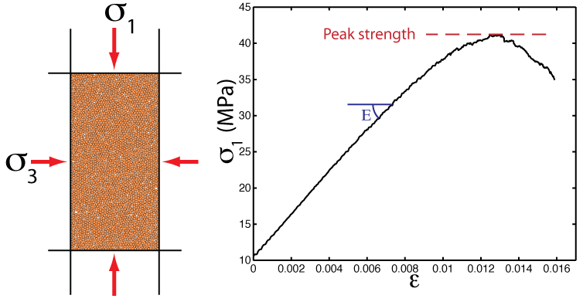
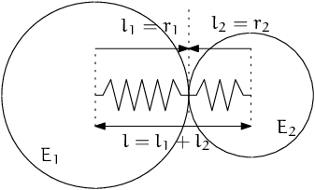
Background
DEM: Discrete Element Model
Microgranular system for macroscopic object
Based on Newtonian mechanics
Masses of computation

Slide 5
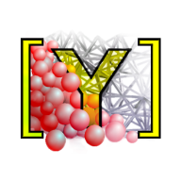
Software
YADE: Yet Another Dynamic Engine
Performed on Linux
Open Source
Python Command Line

Slide 6
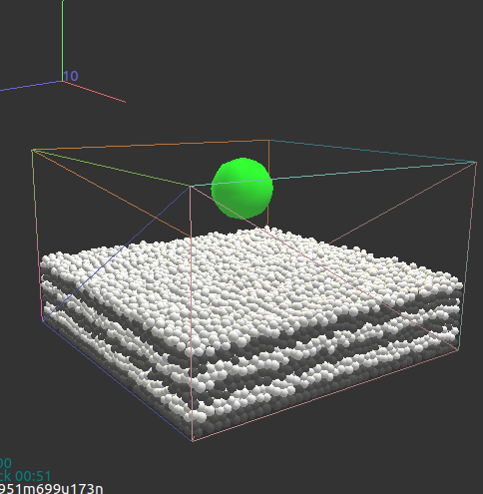
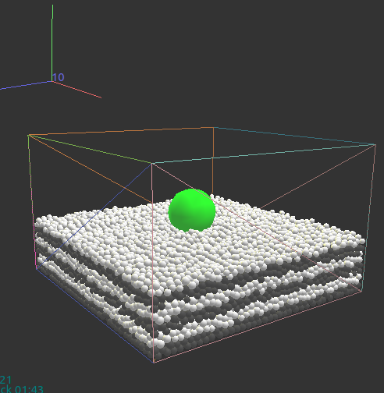
Scenario
Process of aerolite collison

Slide 7
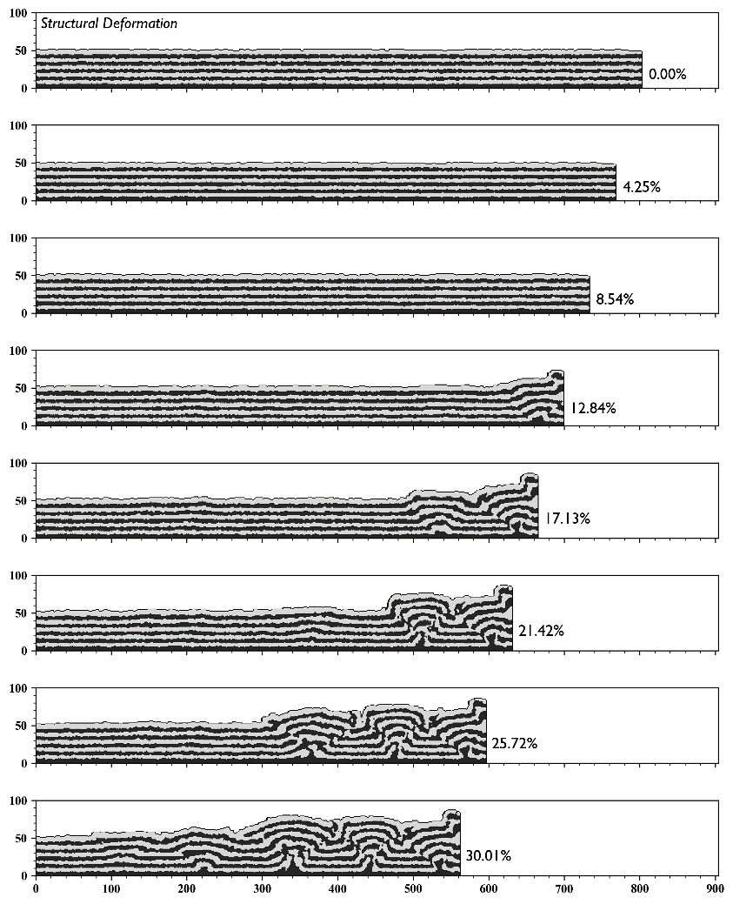
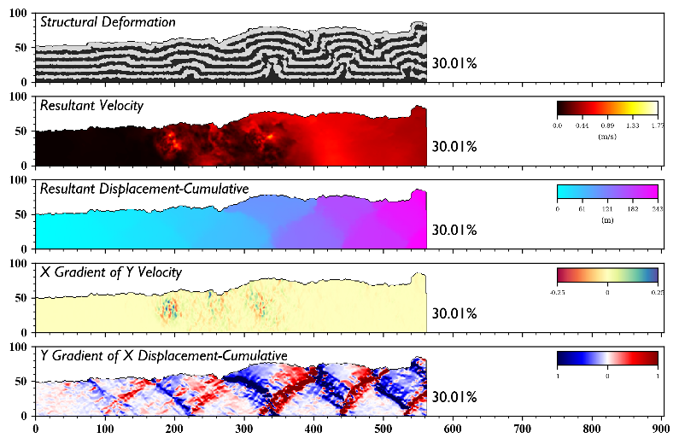
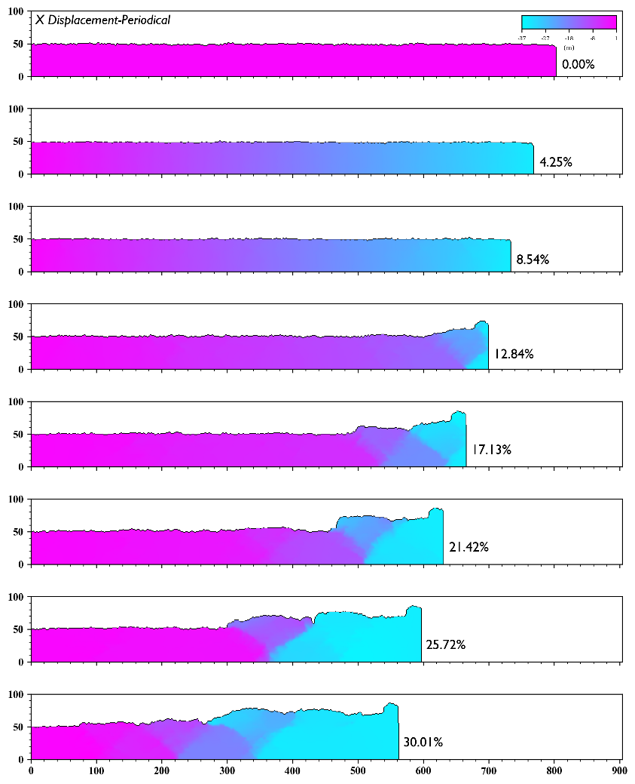
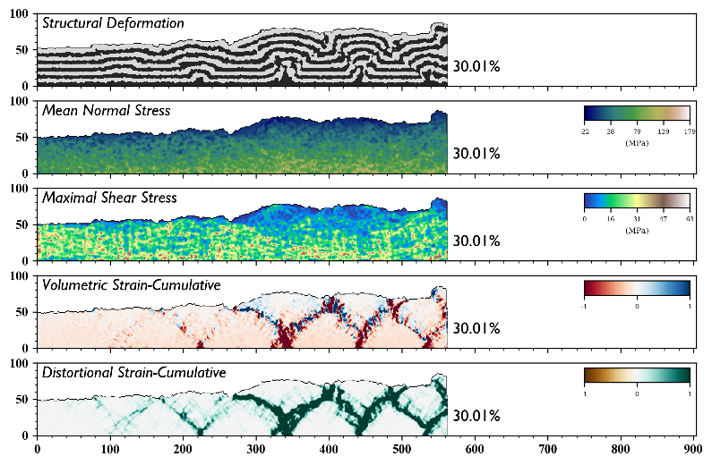
Aim

Slide 8
Content
Background
Algorithm
Experiment
Discussion
Conclusion

Slide 9

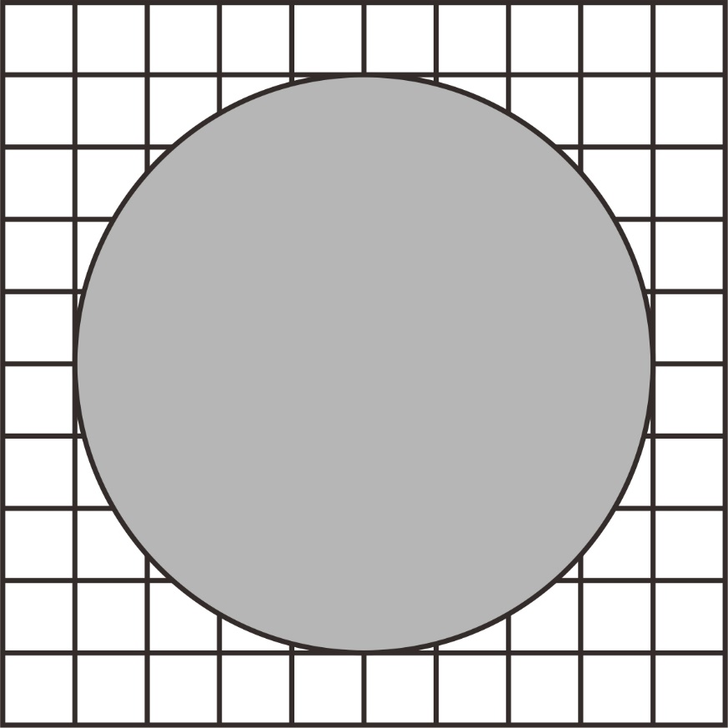
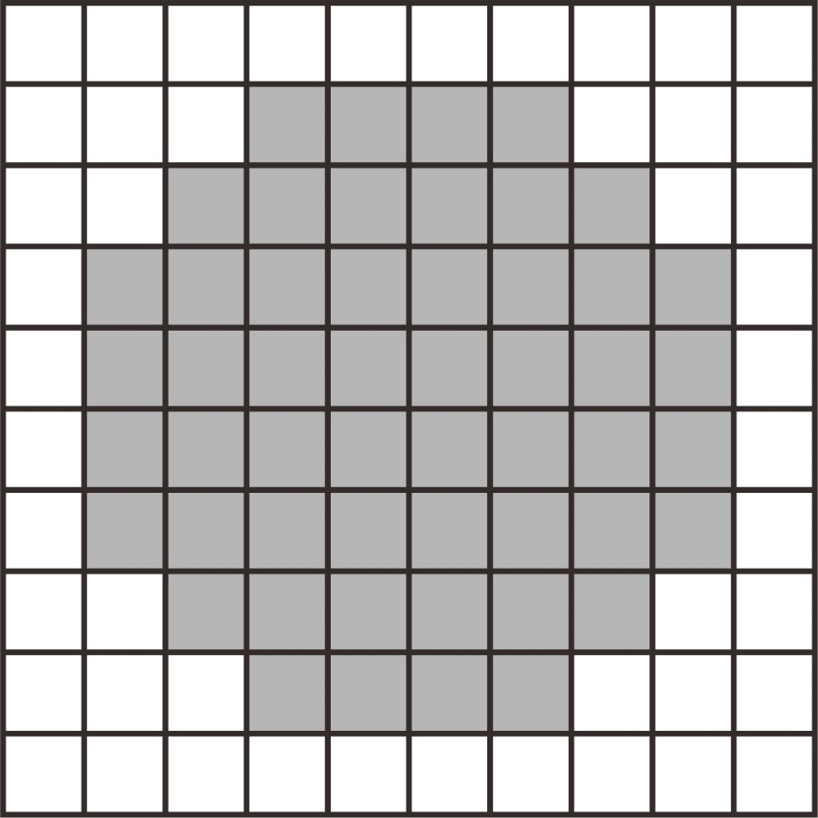


Rasterization
GitHub: https://github.com/jerryweihuajing/Post-Processing

Slide 10
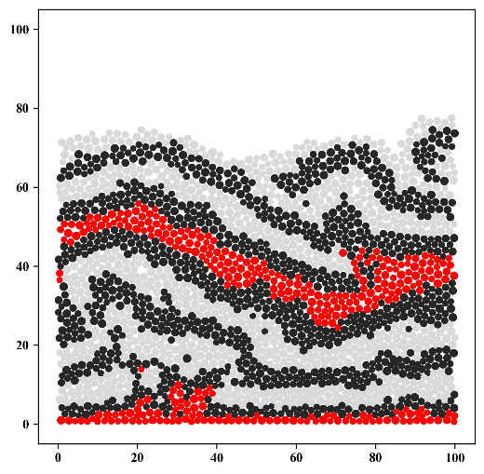
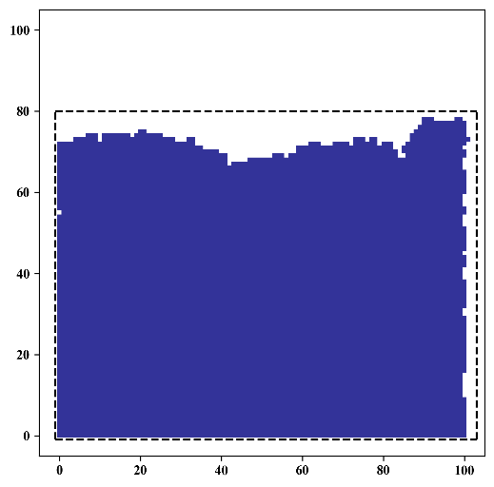
Rasterization
GitHub: https://github.com/jerryweihuajing/Post-Processing

Slide 11
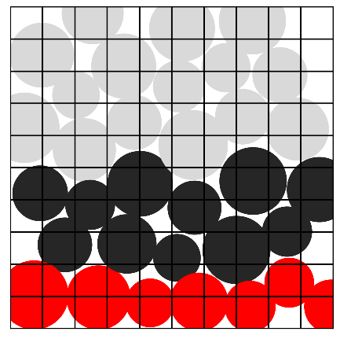
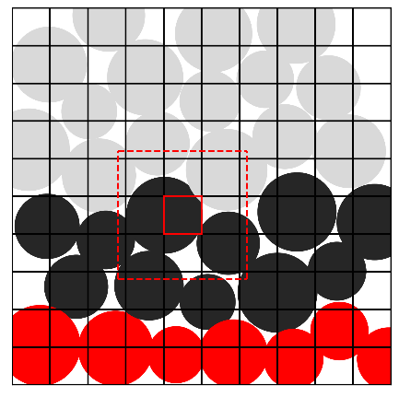
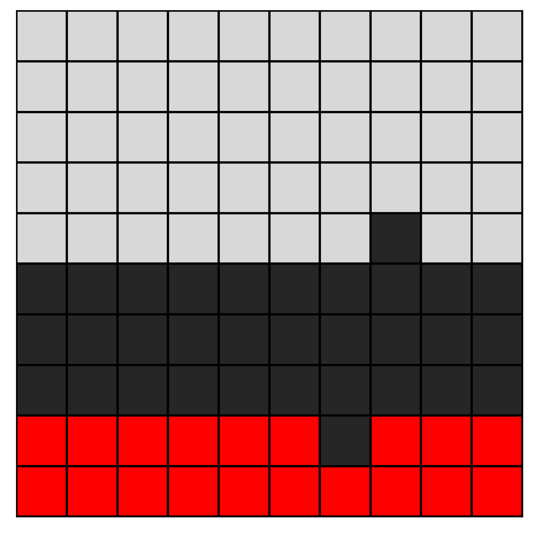
Rasterization
GitHub: https://github.com/jerryweihuajing/Post-Processing

Slide 12

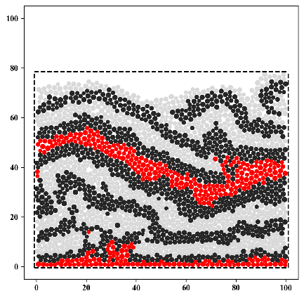
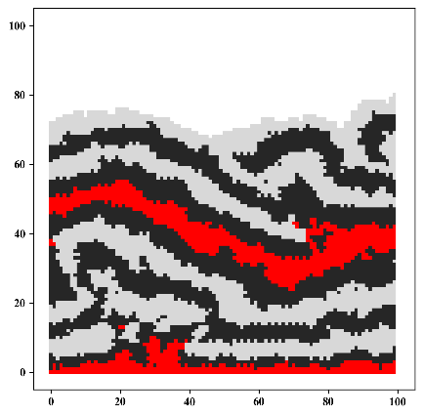
Rasterization
GitHub: https://github.com/jerryweihuajing/Post-Processing

Slide 13
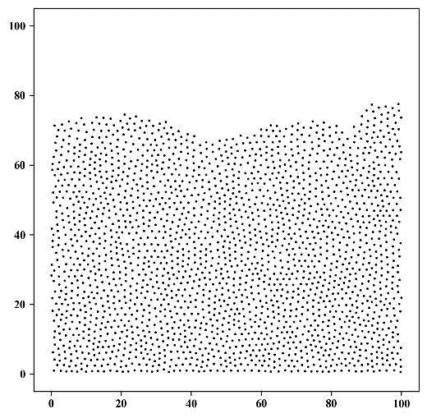
Spatial Interpolation
GitHub: https://github.com/jerryweihuajing/Post-Processing

Slide 14
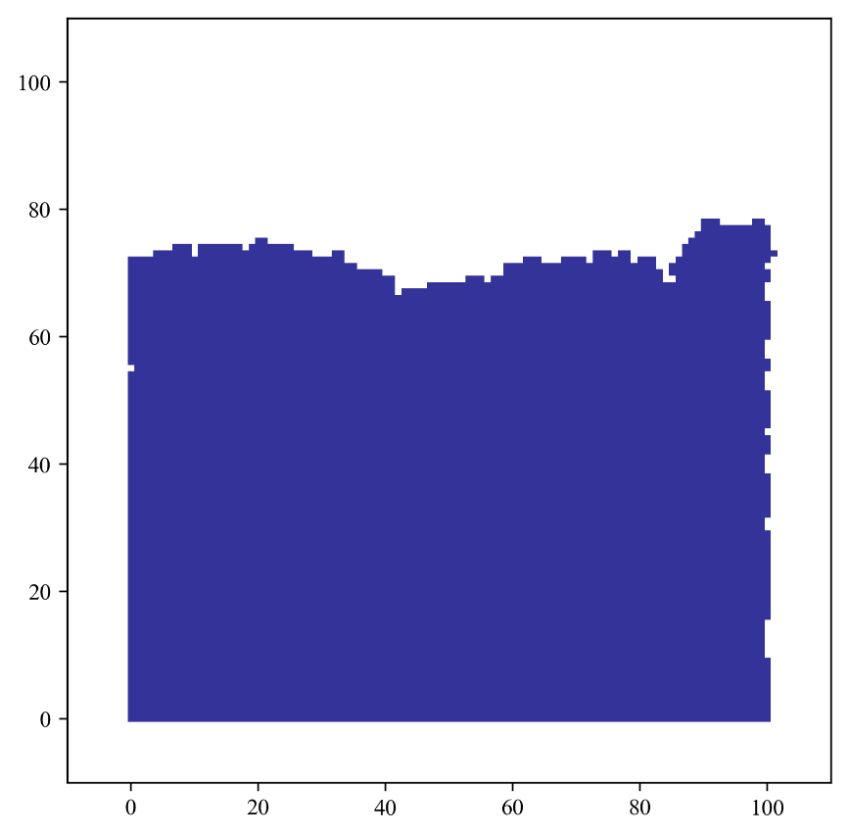
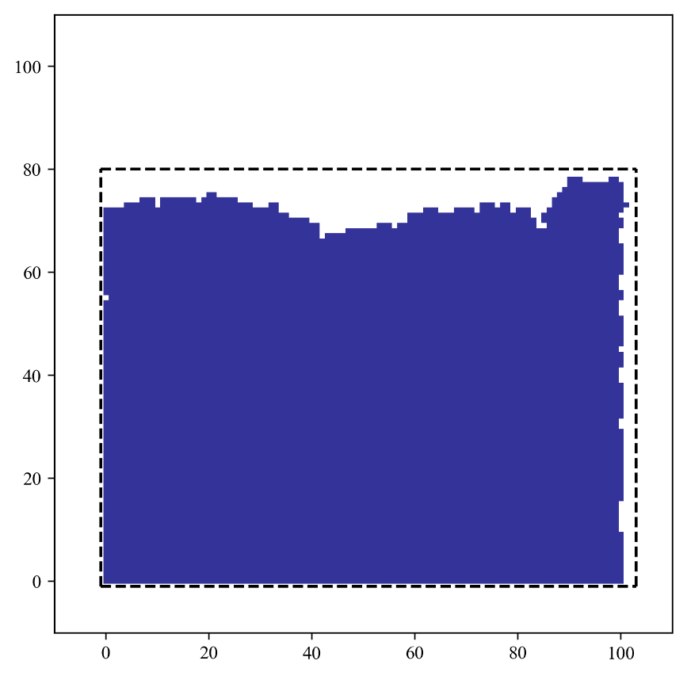
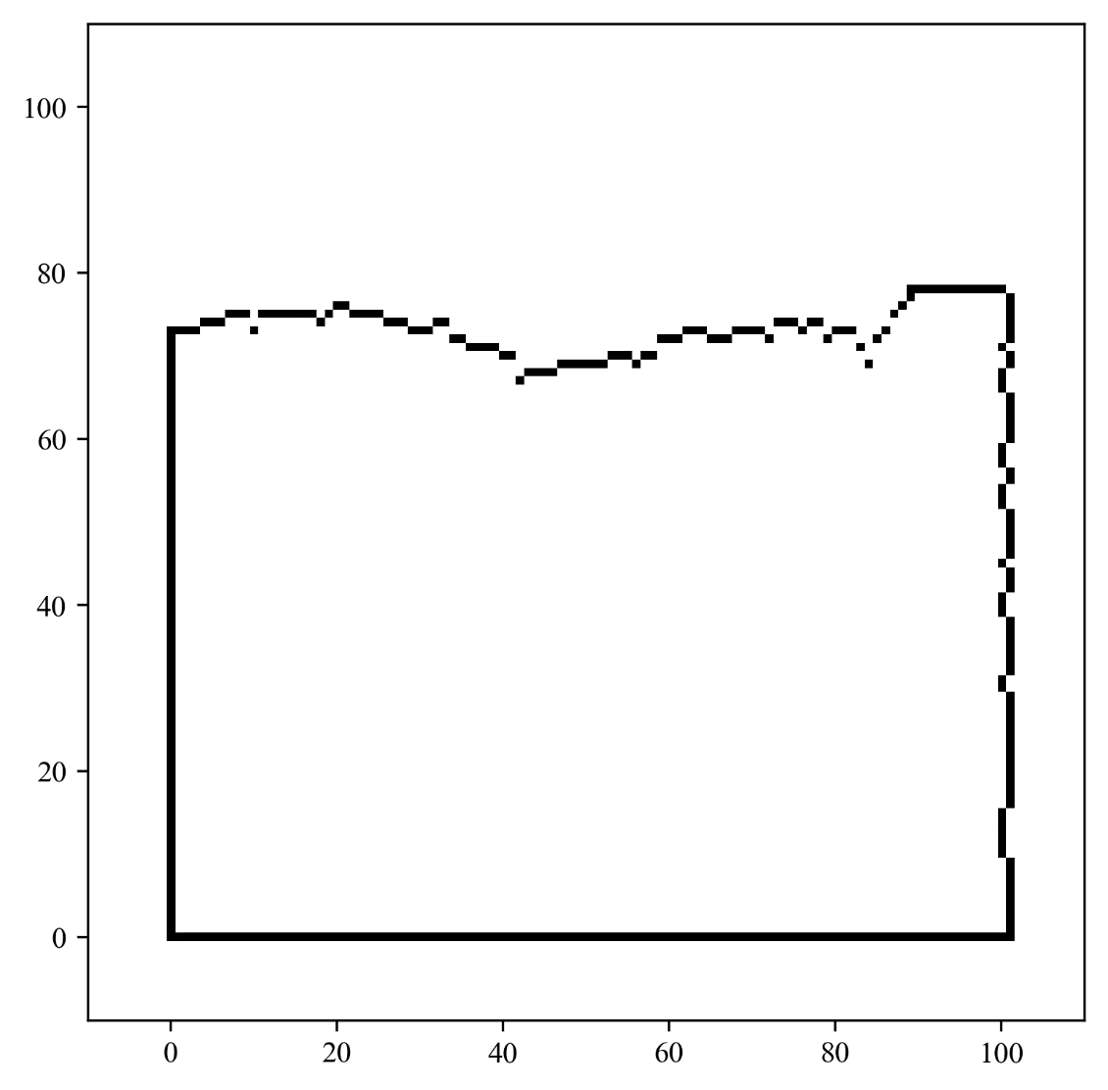
Boundary Extraction
GitHub: https://github.com/jerryweihuajing/Post-Processing

Slide 15
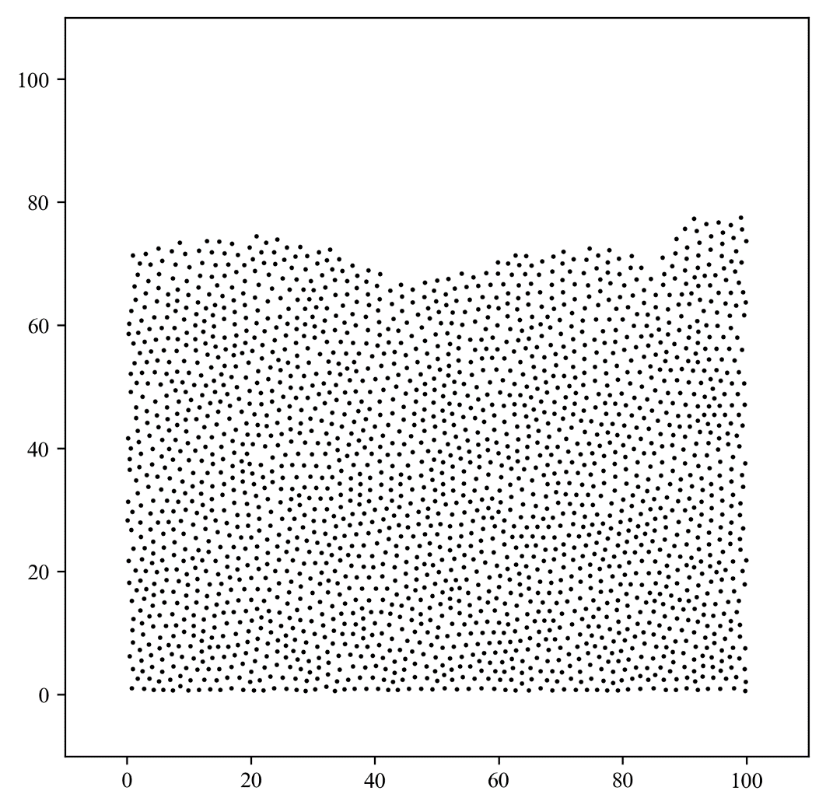
Spatial Interpolation
GitHub: https://github.com/jerryweihuajing/Post-Processing

Slide 16
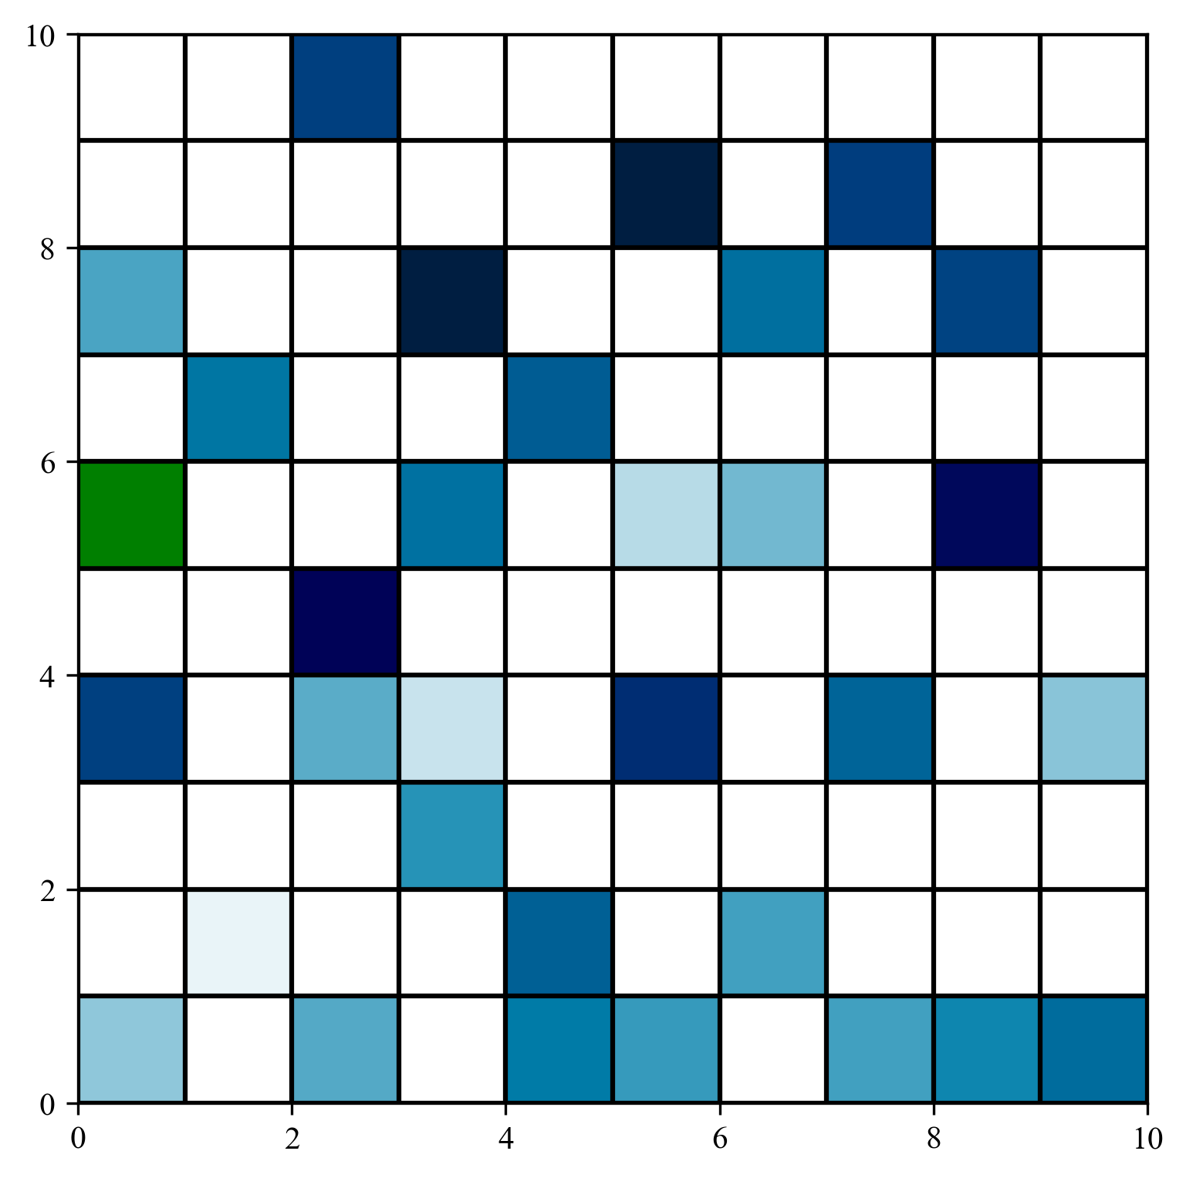
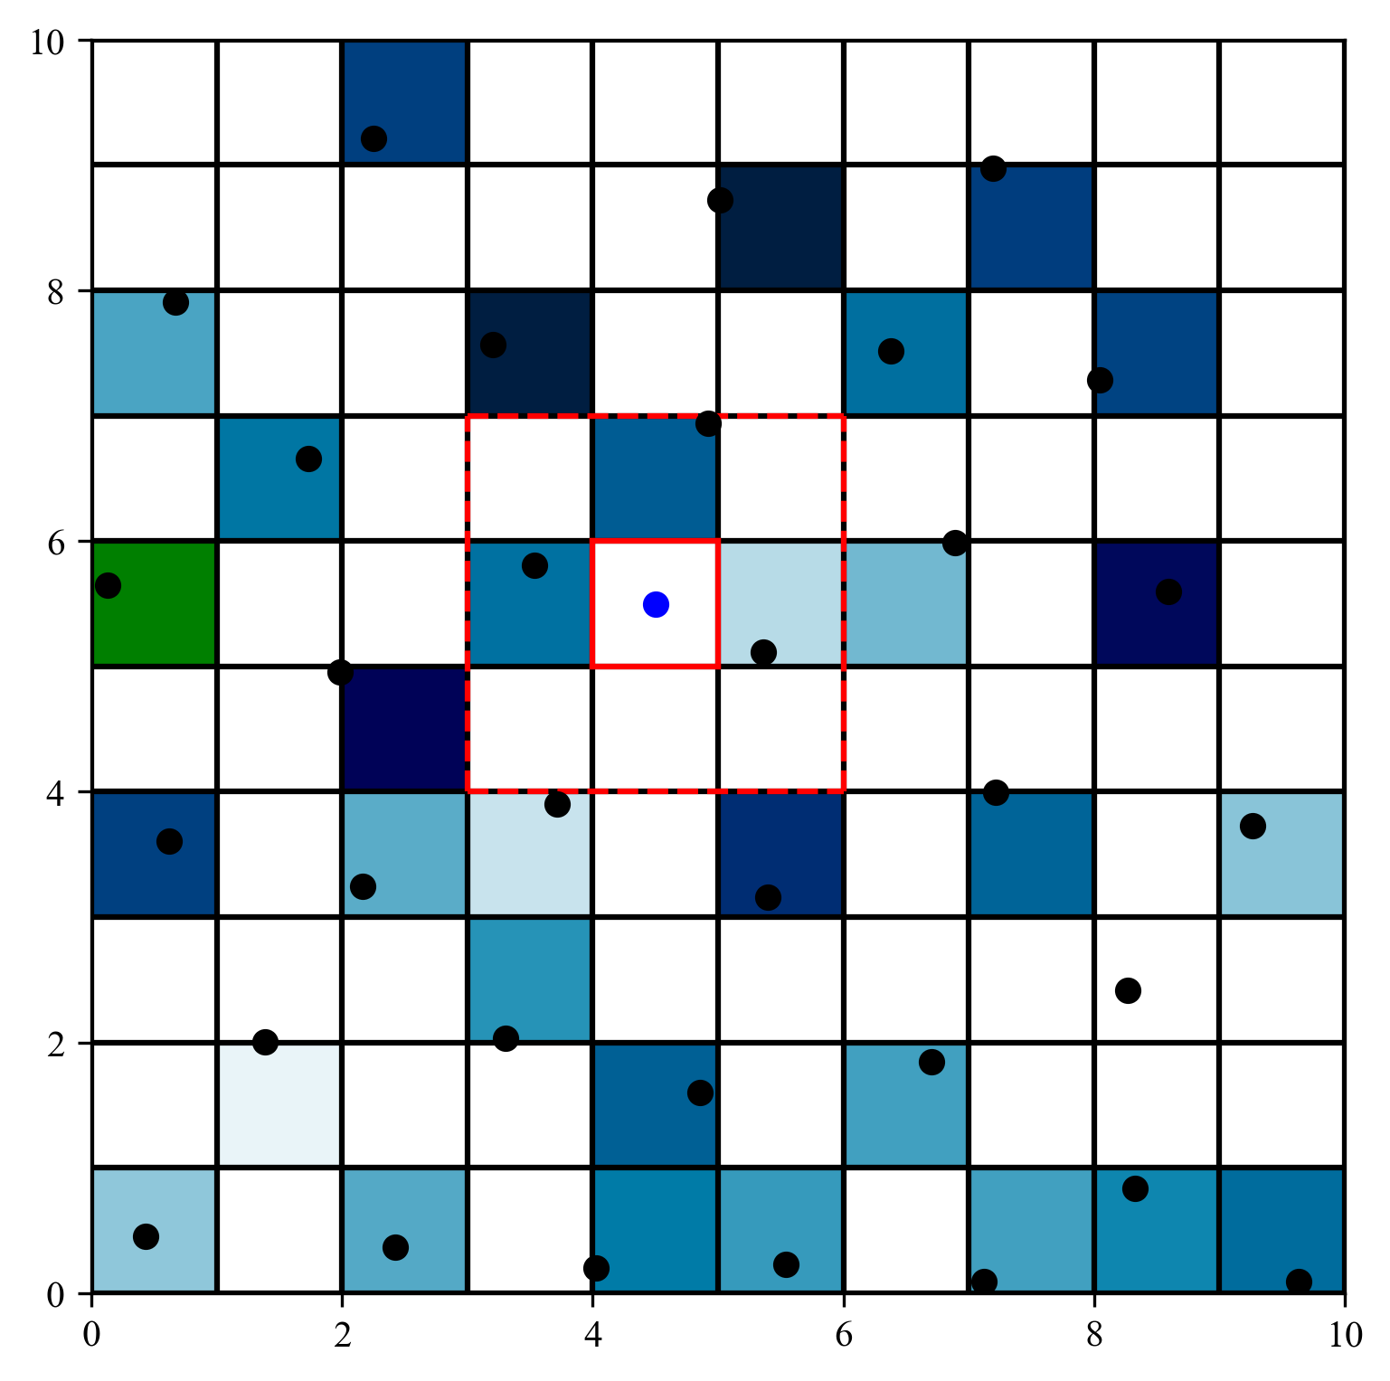
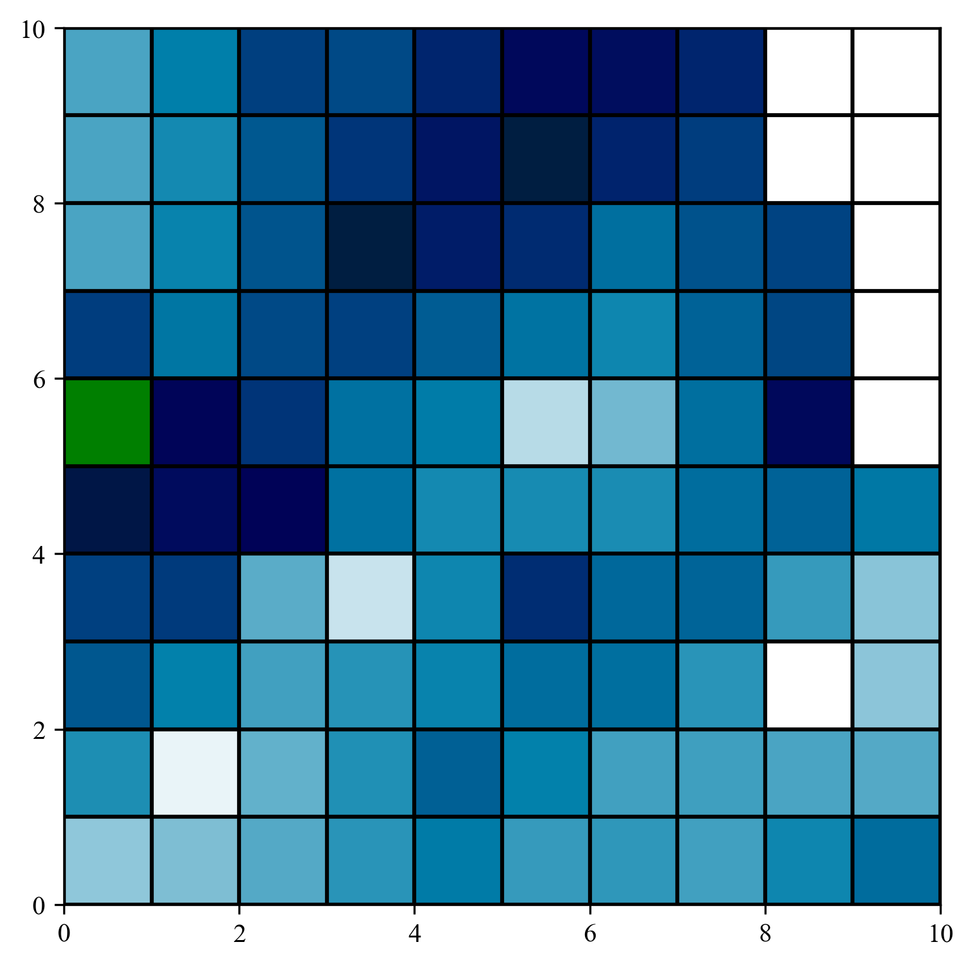
Spatial Interpolation
GitHub: https://github.com/jerryweihuajing/Post-Processing

Slide 17
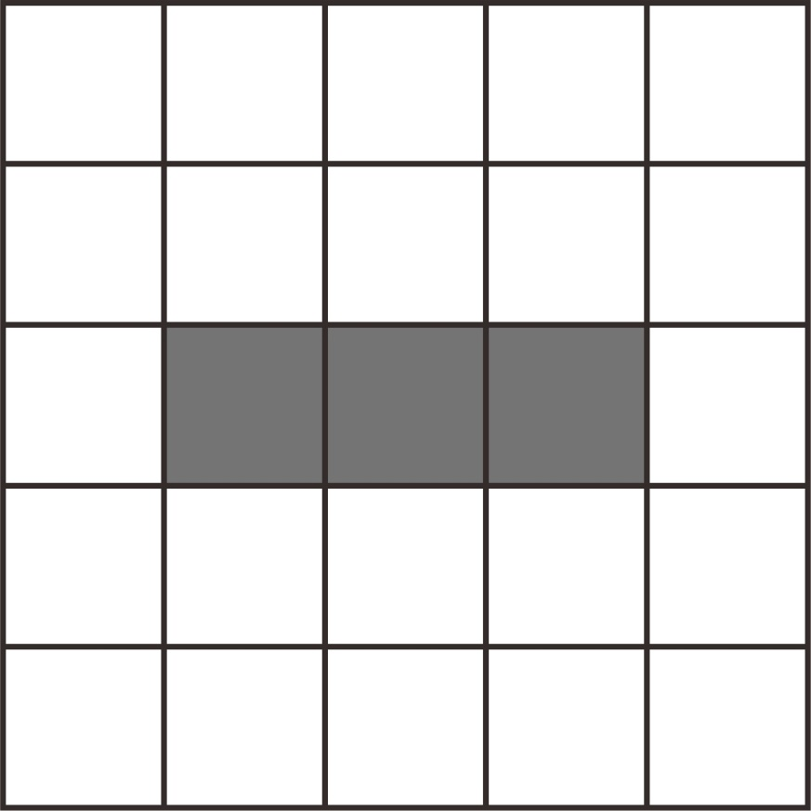
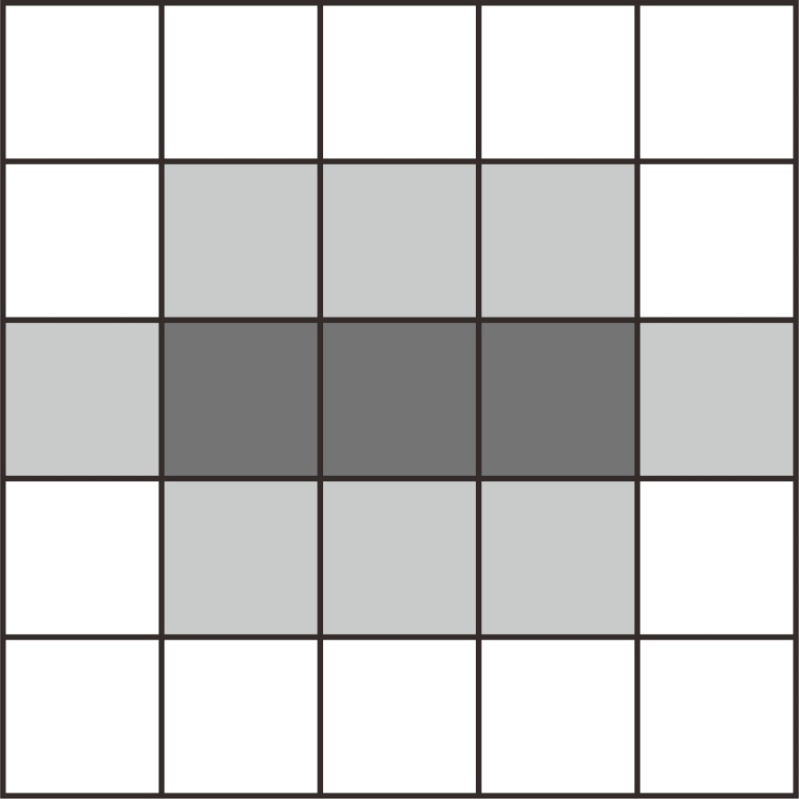
Erosion and Expansion
GitHub: https://github.com/jerryweihuajing/Post-Processing

Slide 18


Erosion and Expansion
Join the boundary to make it complete.
GitHub: https://github.com/jerryweihuajing/Post-Processing

Slide 19
Content
Background
Algorithm
Experiment
Discussion
Conclusion

Slide 20
Conclusion
DEMpost is proved to be reliable.
Salt layer influence tectonics a lot.
Pre-existing fracture has a huge impact in many ways.

Slide 21
Acknowledgement
THANKS

